Slide 1
Lecture 2 - Systems, Subsystems and Systems Integration

Slide 2

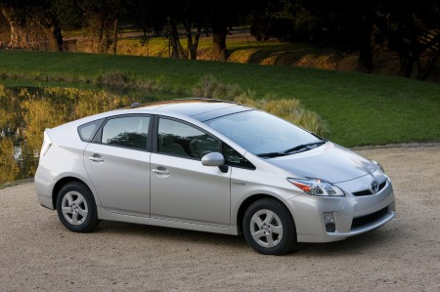
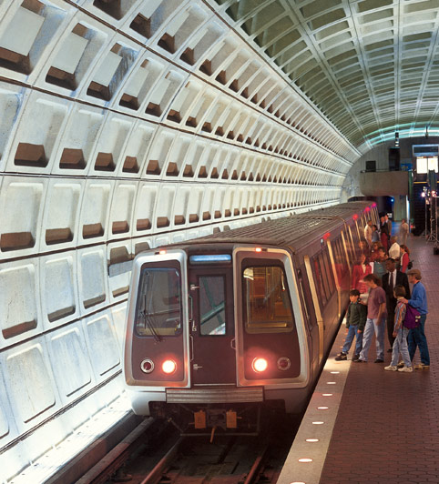
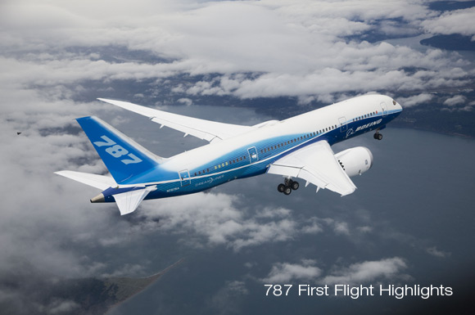
Typical Systems
Personal Computer (PC)
Hybrid Car
DC Metro subway train
Boeing 787 Dreamliner

Slide 3

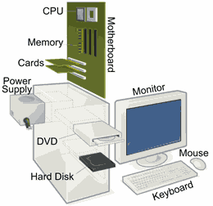
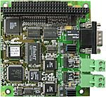
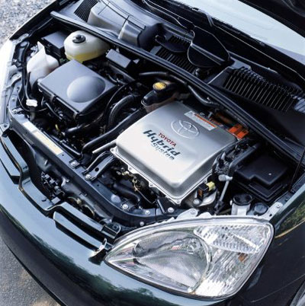
Systems are made of subsystems and components
PC is made of subsystems (monitor, disk, processor), containing components,
typically printed circuit (PC) boards and integrated circuits (ICs)
Hybrid Car contains engine subsystem made of components (combustion and electric drives)

Slide 4
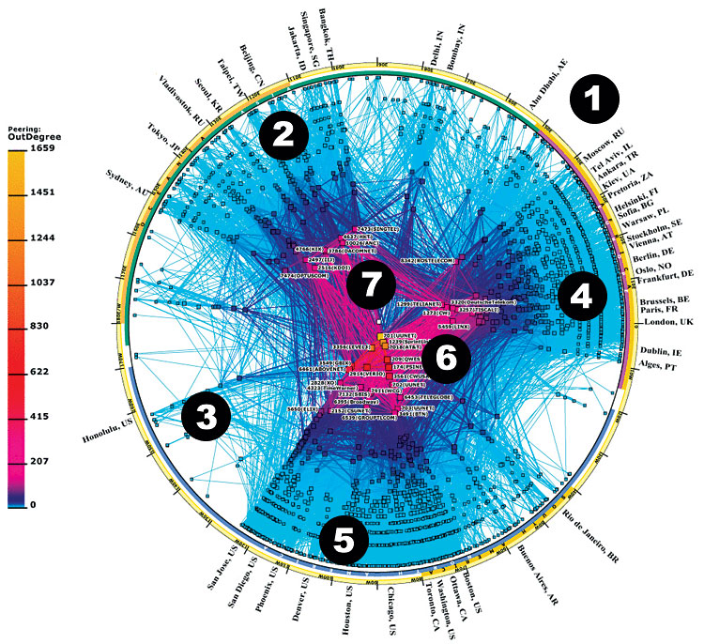
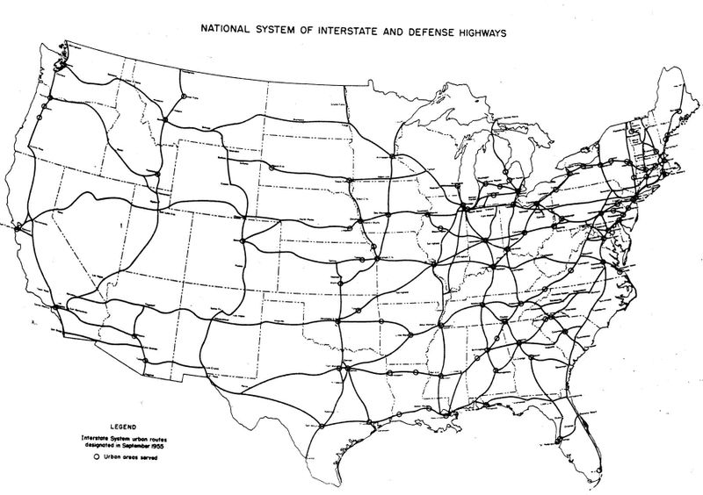
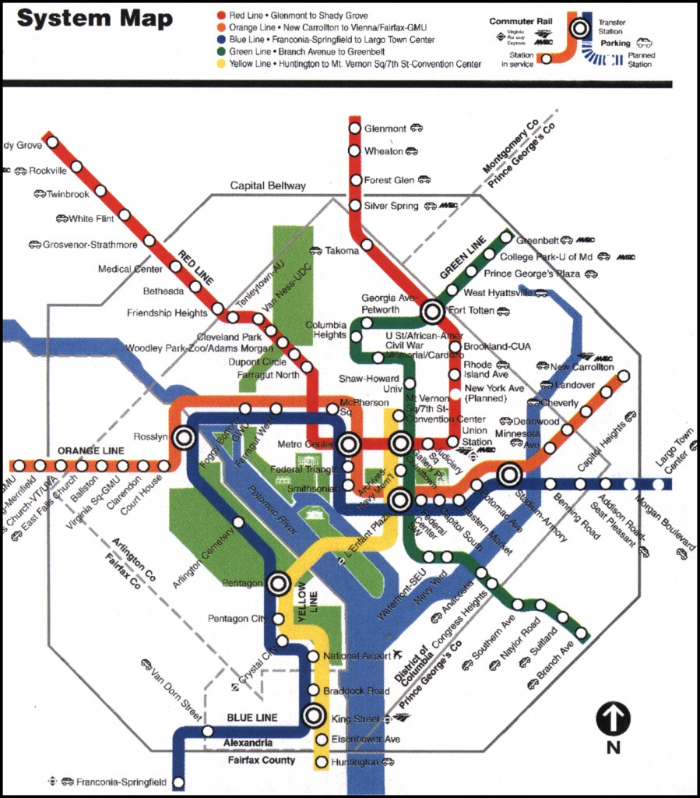
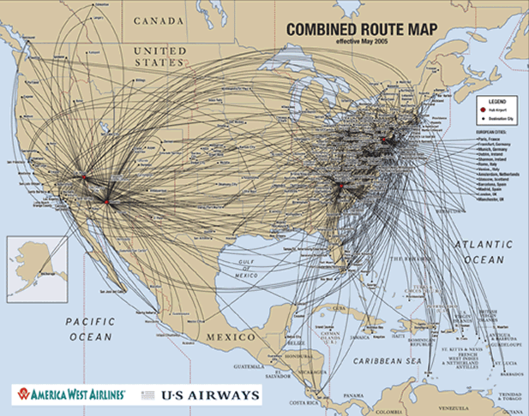
Systems are often parts of larger systems
Car – highway system
PC - part of internet
Subway train – part of subway system
Airliner – airline and routes

Slide 5
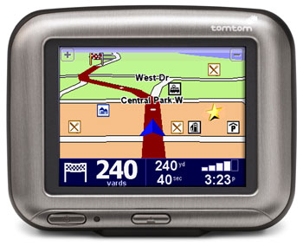
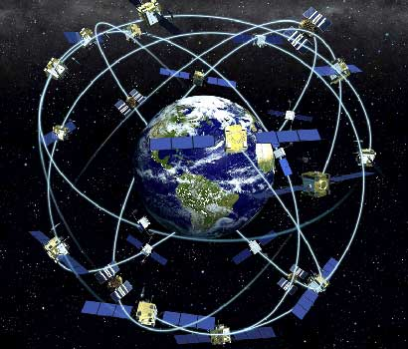
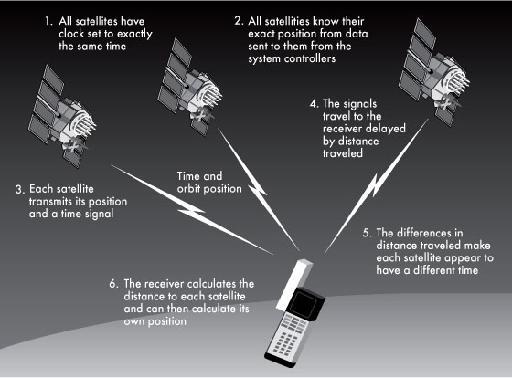
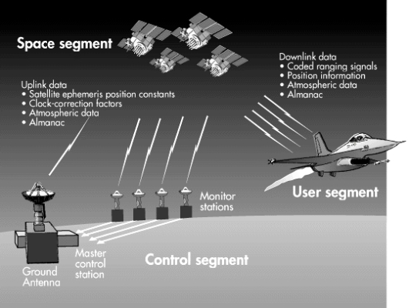
Global Positioning System (GPS)
Receivers, Satellites and Ground stations are each systems which make up the larger GPS system
Notes:
The Global Positioning System is a great example of multiple subsystems working together to make a system. The GPS consists of three major subsystems which they call “segments”. The space segment includes the satellites. The ground segment consists of the ground stations which control the satellites and measure the accuracy of the clocks onboard the satellite which are key to position accuracy. The user segment consists of the individual user GPS positioning devices.
Each of these segments is a significant system to design in themselves. In terms of the total GPS, however they a reconsidered subsystems.
GPS truly is a system of systems. It is often part pf other systems such as aircraft, cars, ships, etc…

Slide 6
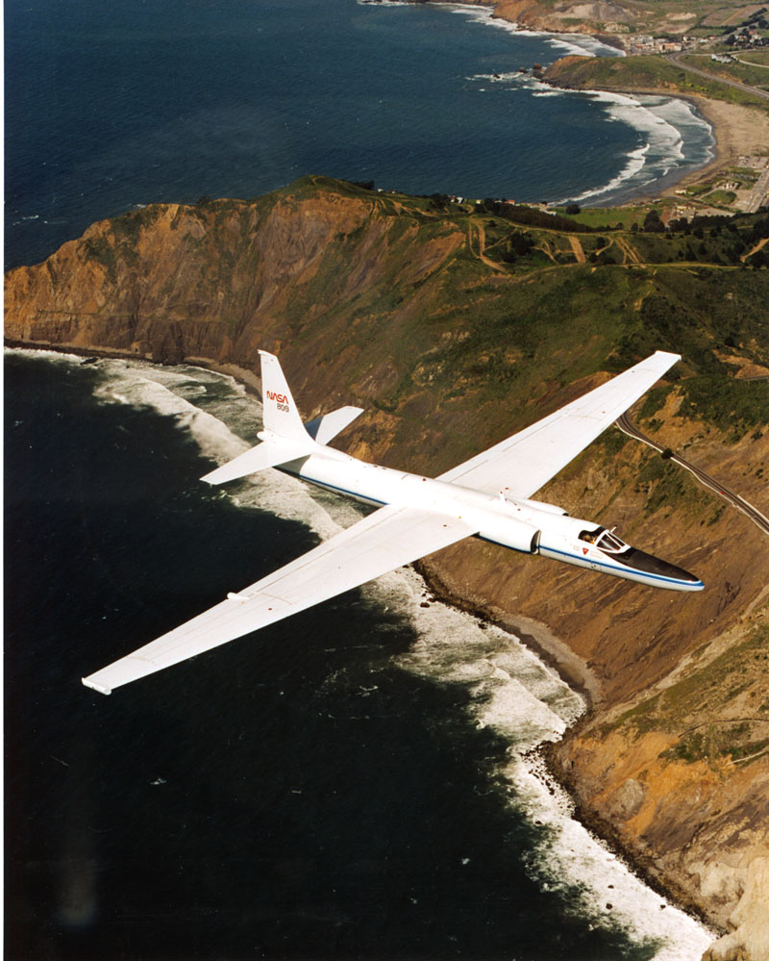
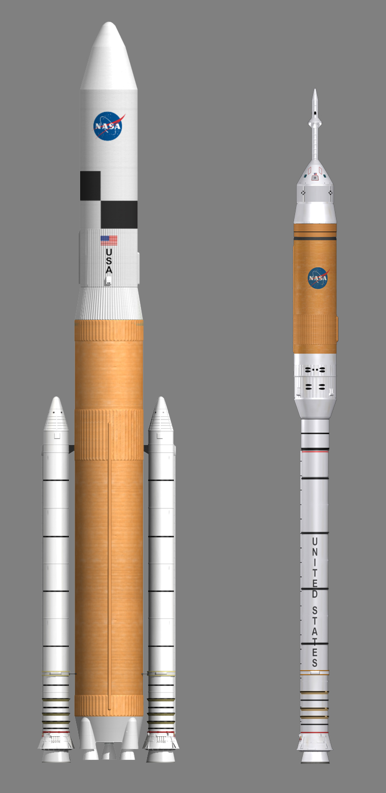
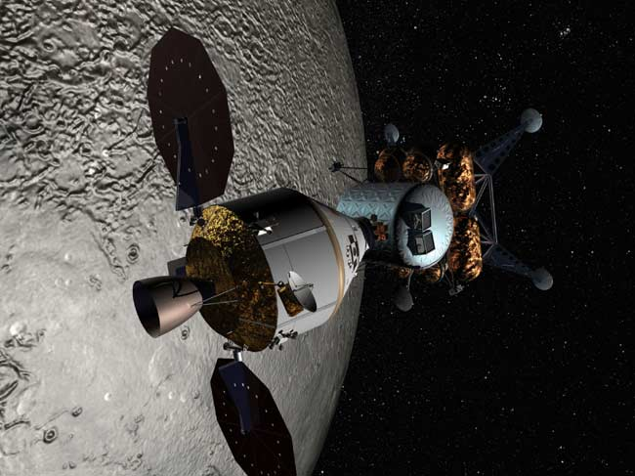
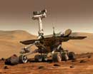
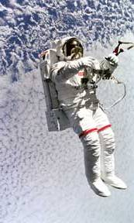
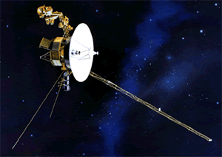
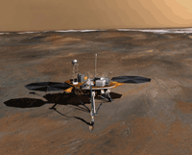
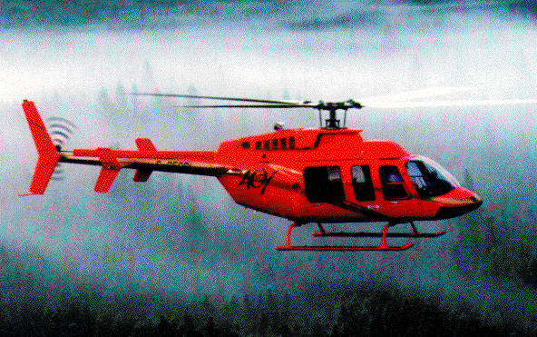
What are typical aerospace systems ?
Aircraft
Human Spacecraft
Rovers
Launch Vehicles
Satellites
Spacesuits
Helicopters
Landers
Notes:
Aerospace engineering produces many different kinds of systems. Eacvh have many different principles of operation however each of them consists of many different types of subsystems which must be organized and integrated for the system to perform its intended function.
Common subsystems include electrical systems, hydraulic systems, life support systems, computer systems, communications systems and guidance, navigation and control systems.

Slide 7
What are typical subsystems in an aerospace system ?
Structure
Propulsion
Guidance, Navigation and Control
Avionics – Computers, Communications and Data Handling, Instrumentation, Navigation Aids (such as Global Positioning Systems), Optics, Audio and Video, Software
Environmental Control
Electrical and auxiliary power systems, power distribution
Mechanisms
Thermal Protection

